Slide 1
CS/RBE 549 COMPUTER VISION
LECTURE 1 – INTRODUCTION AND OPTICS

Slide 2
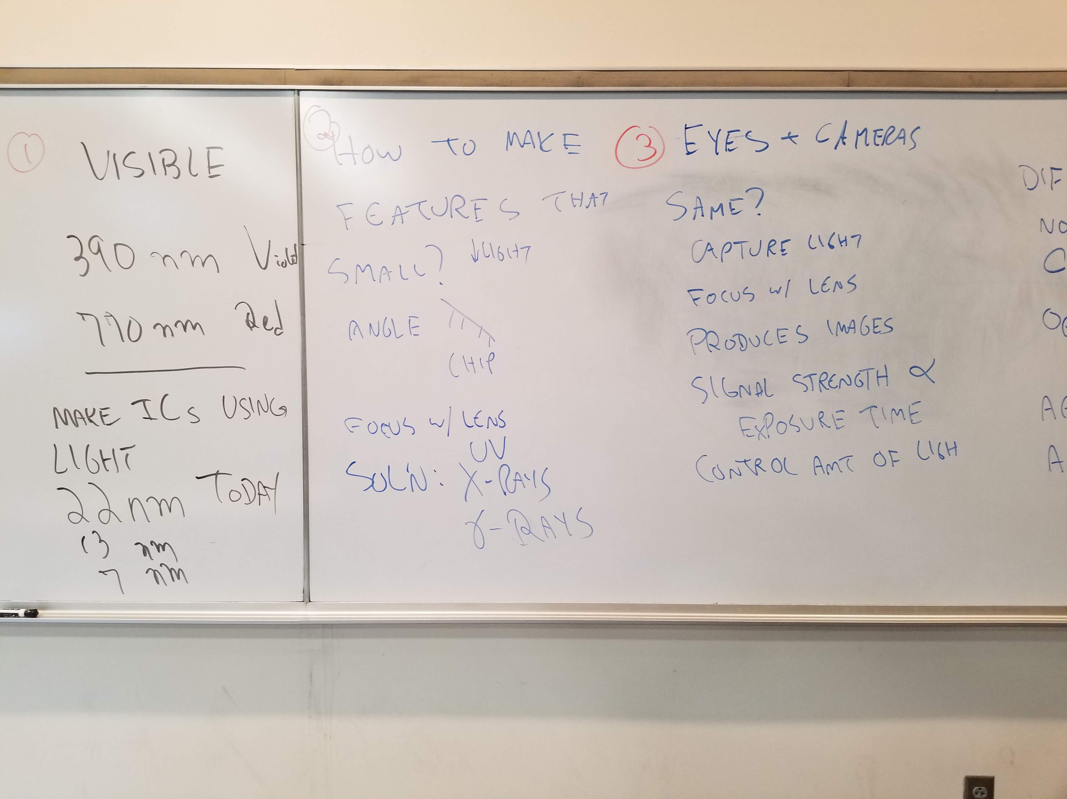

Slide 3
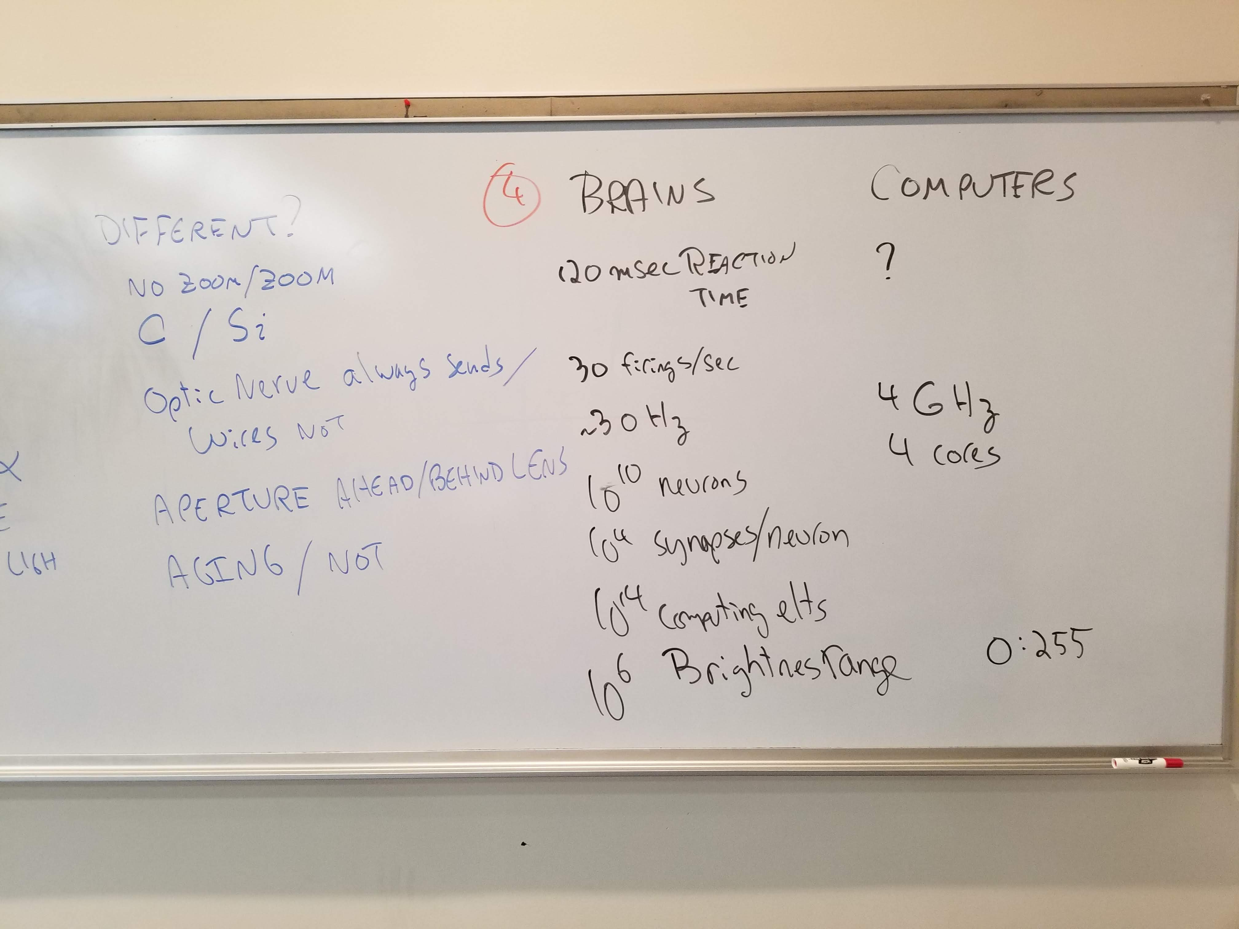

Slide 4
